Slide 1
Higher Education in the United States
By Kimberly Cummings
Monica Wojtczak
Iliana Gonzalez

Slide 2
Mr. President, some things to consider:
How the number of 4 year institutions varies among states
The number of students attending these institutions
The increasing cost of tuition
Affects of financial aid on students

Slide 3
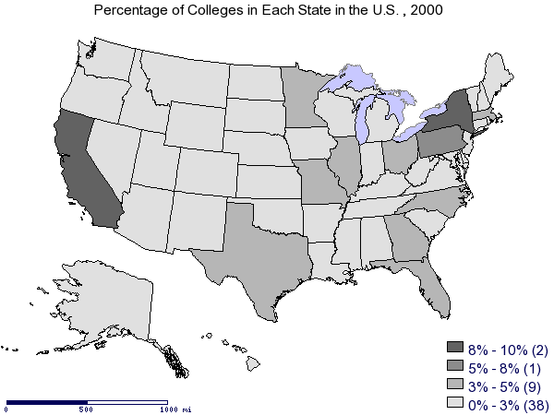
Percent of 4 Year Colleges per State

Slide 4
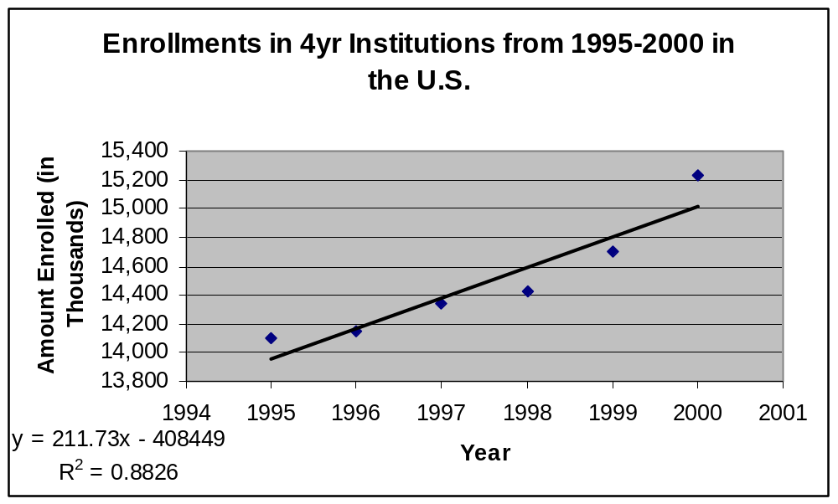
Did You Know…

Slide 5
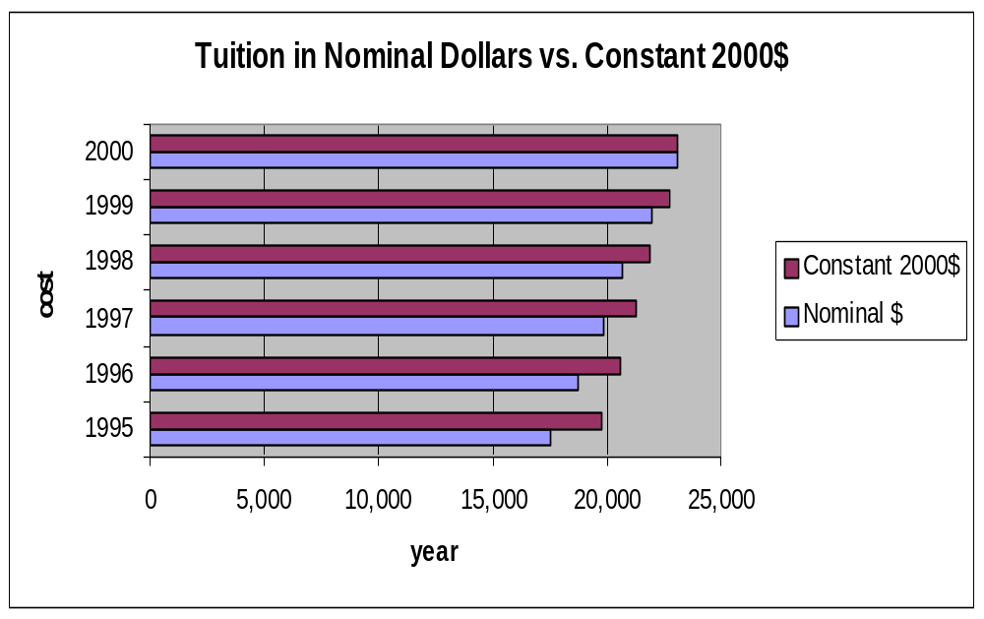
Tuition Costs
Nominal vs. Constant 2000$
Overall Increase

Slide 6
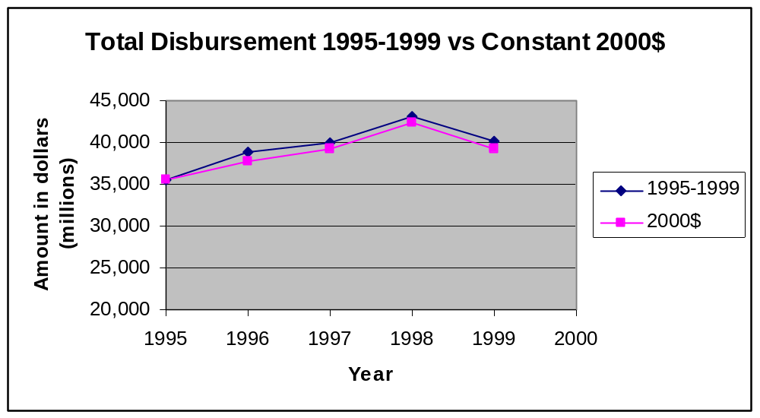
Financial Aid

Slide 7

In Conclusion
Economically, higher education is vital to our country’s well-being.
We need to subsidize higher education more so than in the past
Government needs to take an active role in helping students fund their education.

